Slide 1

MACHINE
INTELLIGENCE
Back propagation
K.S.Srinivas
Department of Computer Science and Engineering

Slide 2

MACHINE INTELLIGENCE
Back propagation
K.S.Srinivas
Department of Computer Science and Engineering

Slide 3
MACHINE INTELLIGENCE
Back Propagation
Before we jump into back propagation ,lets first check derivative of the sigmoid activation that we previously learned about

Slide 4
MACHINE INTELLIGENCE
Derivative of Sigmoid
RECALL
Quotient Rule
Your task!!!
try finding derivative of tanh function

Slide 5
MACHINE INTELLIGENCE
Back Propagation
w1
b1
w2
w3
let us start with a simple network,where each layer has a single perceptron,
determined by three weights and three bias
our go is to understand how sensitive is our cost function is to these variables
that way we know which adjustment to these terms is going to cause the most efficient decrease to the cost function
b2
b3
E(w1,b1,w2,b2,w3,b4)

Slide 6
MACHINE INTELLIGENCE
Back Propagation
Lets label the activation of that last neuron a with a superscript L,indicating which layer its in.
Lets say that the value we want the last activation to be for a given training example is y
a^{(L-2)}
a^{(L-1)}
a^{(L)}
y

Slide 7
MACHINE INTELLIGENCE
Back Propagation
0.66
1
y can be 0 or 1,so the cost for this simple network for a single training example is (a^{L}-y)²
Remember what is a^{L}
Let us make things simpler
we can generalize it in the following way
a^{(L-2)}
a^{(L-1)}
a^{(L)}
y
E₀(.....)=
(0.66-1)²
w^{(L)}
a^{(L-1)}
b^{(L)}
(
w3
a^{(L-1)}
+b3
a^{(L)}=
σ
)
z^{(L)}
z^{(L)}=
w3
a^{(L-1)}
+b3
a^{(L)}=
σ
(z^{(L)})
y
a^{(L)}
E₀

Slide 8
MACHINE INTELLIGENCE
Back Propagation
also a(L-1) is influenced by its own weight
Now lets not focus on it,
The thing is all of this is numbers
our first goal is to understand how sensitive our cost function is to small changes in our weight
w^{(L-1)}
a^{(L-2)}
b^{(L-1)}
z^{(L-1)}
w^{(L)}
a^{(L-1)}
b^{(L)}
z^{(L)}
y
a^{(L)}
E₀

Slide 9
MACHINE INTELLIGENCE
Back Propagation
w^{(L)}
a^{(L-1)}
b^{(L)}
In other words what is the derivative of E with respect to W(L)
this ժw can be said as small nudge in w like ,change by 0.01
and ժE is whatever the resulting nudge to cost E
what we want is their ratio
z^{(L)}
y
a^{(L)}
E₀

Slide 10
MACHINE INTELLIGENCE
Back Propagation
w^{(L)}
a^{(L-1)}
b^{(L)}
conceptually this tiny nudge to w^(L) causes some nudge to z^(L) ,
which in turn causes some nudge to a^(L)
which directly influences the cost
z^{(L)}
y
a^{(L)}
E₀

Slide 11
MACHINE INTELLIGENCE
Back Propagation
w^{(L)}
a^{(L-1)}
b^{(L)}
so with that let us break things up
This is nothing but the chain rule
w^{(L)}
z^{(L)}
z^{(L)}
z^{(L)}
a^{(L)}
a^{(L)}
y
a^{(L)}
E₀
E₀

Slide 12
MACHINE INTELLIGENCE
Back Propagation
Let us recall eqn of E
The derivative of this wrt to a^L would be

Slide 13
MACHINE INTELLIGENCE
Back Propagation
Let us recall eqn of a^(L)
The derivative of this wrt to z^L would be

Slide 14
MACHINE INTELLIGENCE
Back Propagation
now lets check the equation of z^L
The derivative of this wrt to w^L would be

Slide 15
MACHINE INTELLIGENCE
Back Propagation
putting all this together

Slide 16
MACHINE INTELLIGENCE
Back Propagation
putting all this together
this is for one example ,generalizing for n examples

Slide 17
MACHINE INTELLIGENCE
Back Propagation
this is just one component of the gradient
even though its one of many partial derivatives we need its more than 50% of our work

Slide 18
MACHINE INTELLIGENCE
Back Propagation
the derivative wrt to bias is almost identical
we just need to replace this with derivative of z^L wrt to b^L
and that turns out to be 1

Slide 19
MACHINE INTELLIGENCE
Back Propagation
this were topic of back propagation comes in
w^{(L)}
a^{(L-1)}
b^{(L)}
z^{(L)}
y
a^{(L)}
E₀

Slide 20
MACHINE INTELLIGENCE
Back Propagation
this were topic of back propagation comes in
w^{(L)}
a^{(L-1)}
b^{(L)}
z^{(L)}
y
a^{(L)}
E₀

Slide 21
MACHINE INTELLIGENCE
Back Propagation
let us bring back the equation again and see the derivative

Slide 22
MACHINE INTELLIGENCE
Back Propagation
now we can keep iterating this chain rule idea backwards,to see how sensitive the cost function is to the previous weights and biases
w^{(L-1)}
a^{(L-2)}
b^{(L-1)}
z^{(L-1)}
w^{(L)}
a^{(L-1)}
b^{(L)}
z^{(L)}
y
a^{(L)}
C₀

Slide 23
MACHINE INTELLIGENCE
Back Propagation
this look simple since all layers all one neuron
and things is going to get exponentially complicated when we give more layers to neuron
But honestly,not that much changes
its just few more indices we need to keep track of

Slide 24
MACHINE INTELLIGENCE
Back Propagation
rather than activation of a given layer being a^L,its also going it have a subscript indicating which neuron of that layer it is
a^{(L-1)}
a₀^{(L-1)}
a^{(L)}
a₀^{(L)}
a₁^{(L-1)}
a₁^{(L)}
a₂^{(L-1)}

Slide 25
MACHINE INTELLIGENCE
Back Propagation
lets use letter k to index the layer L-1 and letter j to index the layer L
a_{k}^{(L-1)}
a_{j}^{(L)}

Slide 26
MACHINE INTELLIGENCE
Back Propagation
for the cost ,again we look at what the desired output is ,but this time we add up the squares of the differences between the last layers activation and the desired output
a_{j}^{(L)}
a_{k}^{(L-1)}
y0
y1

Slide 27
MACHINE INTELLIGENCE
Back Propagation
since there lot more weights ,each one has to have couple more indices to keep track of where it is
let call the weight of the edge connecting the kth neuron in L-1 layer to jth neuron in L layer as W_{jk}^{L}
a_{j}^{(L)}
y0
W_{jk}^{L}
a_{k}^{(L-1)}
y1

Slide 28
MACHINE INTELLIGENCE
Back Propagation
just as before ,its nice to give name to relevant weighted sum,like z
so that activation of the last layer from the j neuron is just our special function applied to z
a_{j}^{(L)}
y0
W_{jk}^{L}
a_{k}^{(L-1)}
y1

Slide 29
MACHINE INTELLIGENCE
Back Propagation
similarly our derivative terms that we derived previously gets indices ,take a pause and analyse
a_{j}^{(L)}
y0
W_{jk}^{L}
a_{k}^{(L-1)}
y1

Slide 30
MACHINE INTELLIGENCE
Back Propagation
what doe change is derivative of cost with respect to one of the activation in the layer (L-1)
in this case the difference is the neuron influences the cost function through multiple paths
a_{j}^{(L)}
y0
W_{jk}^{L}
a_{k}^{(L-1)}
y1

Slide 31
MACHINE INTELLIGENCE
once we know how sensitive the cost function is to the previous layer we can just repeat the process for other previous layer
a_{j}^{(L)}
y0
W_{jk}^{L}
a_{k}^{(L-1)}
y1

Slide 32
MACHINE INTELLIGENCE
Back Propagation
once we know how sensitive the cost function is to the previous layer we can just repeat the process for other previous layer
a_{j}^{(L)}
y0
W_{jk}^{L}
a_{k}^{(L-1)}
y1

Slide 33
MACHINE INTELLIGENCE
Back Propagation
once before we conclude let us see the back propagation between the input layer and first hidden layer .
where j is the first hidden layer and i is the input layer,and let k be the output layer
lets us use the same chain rule friend

Slide 34
MACHINE INTELLIGENCE
Back Propagation
let us expand it more again using chain rule
we have already derived similar equation previously ,we will use the same knowledge

Slide 35
MACHINE INTELLIGENCE
Back Propagation
lets recall once what we have learned till now
for a hidden layer and output layer
where j represents a hidden layer neuron and k represents a last layer neuron

Slide 36
MACHINE INTELLIGENCE
Back Propagation
for a input layer and hidden layer layer
where j represents a hidden layer neuron and i represents a input layer neuron

Slide 37
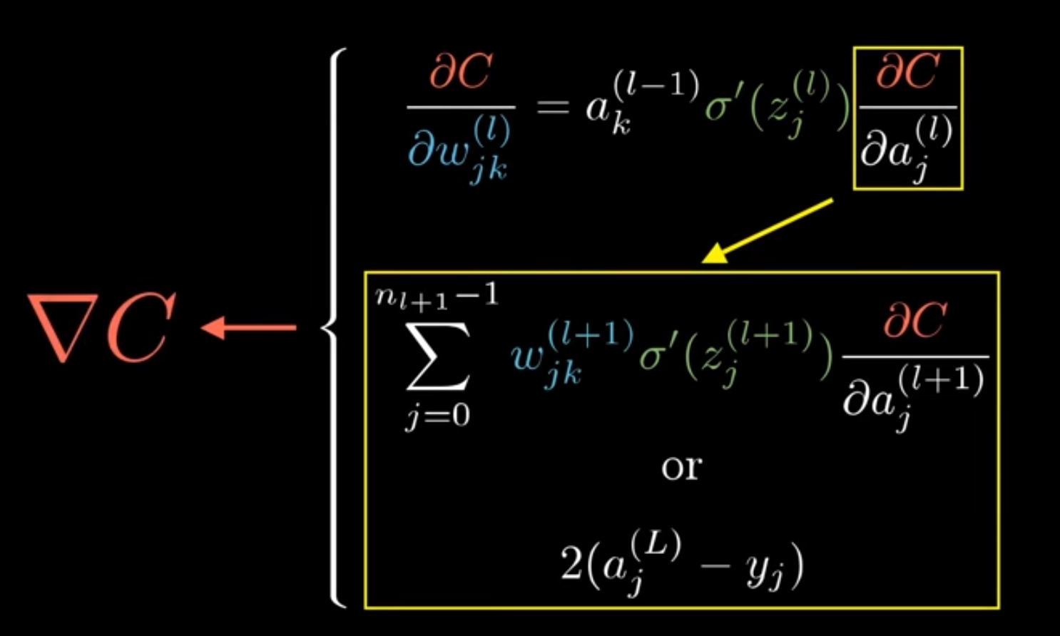
MACHINE INTELLIGENCE
Back Propagation
If all of this makes sense ,we have now looked deep into the heart of back propagation,
these chain rule expression gives us the derivative that determines each component in the gradient,that helps minimize the cost of the network by repatedly stepping downhill

Slide 38
THANK YOU
K.S.Srinivas
srinivasks@pes.edu
+91 80 2672 1983 Extn 701

